Slide 1
Car accident severity predictor
Yaw Botwe

Slide 2
Introduction and business problem
Many factors such as weather, road and lighting conditions influence the severity of accidents
Aim: to predict the severity of car accidents through reliable and robust machine learning models
Results are of particular interest to SDOT Traffic Management Division
Also beneficial to warn drivers in case of bad road/weather/light conditions
Could also help in developing improved Driver assistance systems, capable of handling such challenging situations

Slide 3
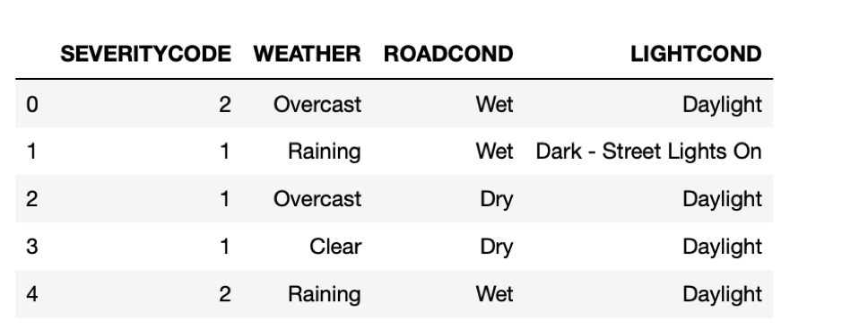
Data Understanding and preprocessing
Data has 37 independent variables and 194,673 records
Independent variables: “WEATHER”, “ROADCOND” and “LIGHTCOND”
Dependent variable/ target: “SEVERITYCODE” (0 to 4 levels)

Slide 4
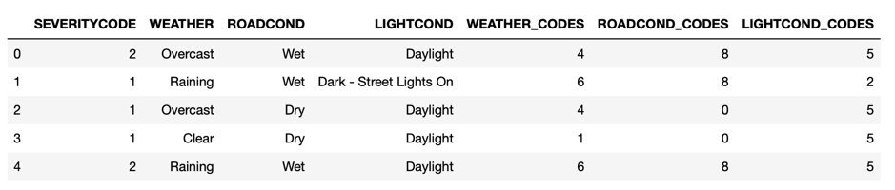
Data Understanding and preprocessing
Label encoding was performed on independent variables to get the data in a format that can be used easily by machine learning models.
The dataset was then balanced using majority downsampling method.

Slide 5
Methodology
Supervised learning models will be built using this data to predict the severity of an accident based on the inputs
The dataset has pre-defined severity codes making it a classification problem
Approaches used:
K Nearest Neighbour:
Support Vector Machines
Decision Trees

Slide 6
Normalization and Dataset split
Feature vectors are rescaled between 0 and 1, in order to prevent bias
A split of 3:1 has been chosen
The models would be trained using 75% of the dataset. The rest 25% of the dataset is the test set, on which the model evaluation is performed
This is done to prevent overfitting

Slide 7
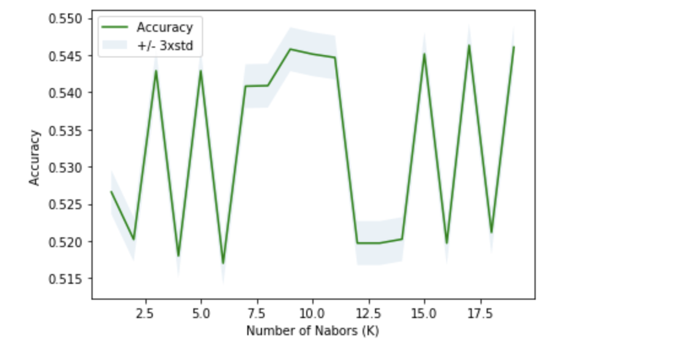
K Nearest Neighbours Model
Along with creating a KNN model, it is also essential that the correct value of K is identified
The value of K which provides the most accurate results on the test dataset would be chosen as the ideal K
In order to find this, a range of values of K starting from 1 until 20 are chosen
The accuracy on the test dataset is calculated and the K pertaining to the maximum accuracy is chosen

Slide 8
Support Vector machine
For support vector machines, the efficiency of the model depends on the type of kernel that is selected.
A general rule of thumb is that a linear kernel is used for linear problems and the radial basis function kernel for non-linear problems.
Since the problem is non-linear in nature, the radial basis function kernel was used.

Slide 9
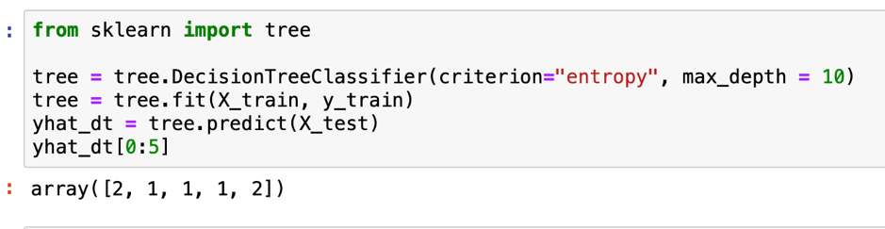
Decision Tree
A decision tree is also built using the training set
Different values of the depth is experimented with and the model corresponding to the highest accuracy is chosen

Slide 10
Results and Evaluation
It is important to check how the different models perform using some evaluation metrics
There are different metrics that are compared:
Jaccard similarity score
F1 score

Slide 11
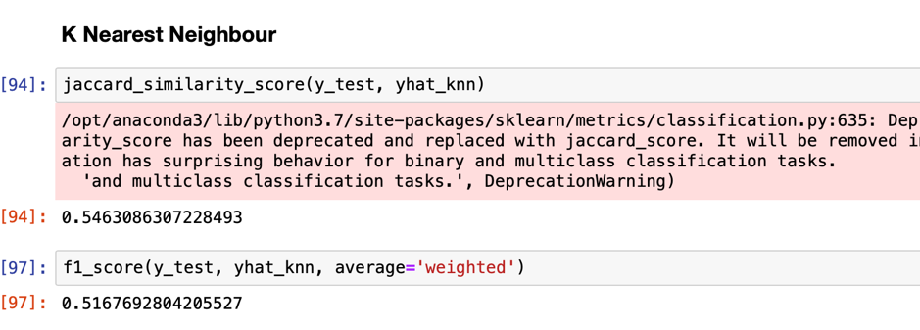
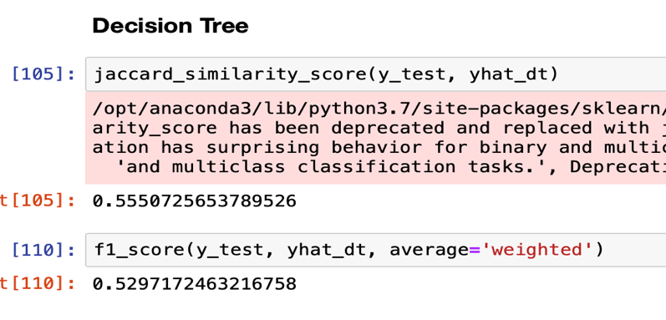
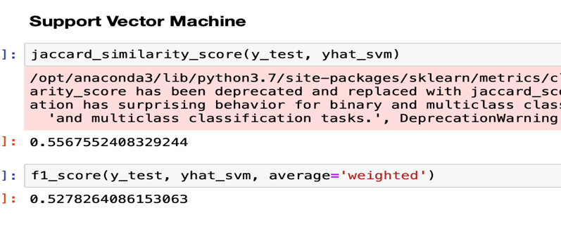
Results and Evaluation

Slide 12
Discussion
For this project, an accuracy of 55.6% was achieved by the SVM model. There is however a significant variance that could not be predicted by the models in this study.
I believe features like speed or uninterrupted time of traveling could be used to predict a more accurate classification.
The next step on this problem could be to add an accident prediction model able to not just predict the accuracy but also the critical time and spots where potential accidents can occur in advance.

Slide 13
Conclusion
In this study, I analyzed the relationship between severity of car accidents and some characteristics which describe the situation that involved the accident.
These models can have multiple application in real life. For instance, imagine that emergency services have an application with some default features such as date, time and department/municipality and then with the information given by the witness calling to inform on the accident they could predict the severity of the accident before getting there and so alert nearby hospitals and prepare with the necessary equipment and staff.

